Slide 1
“The Balance Sheet Awakens”: Managing CU Strategy in an Election Year
Mid-Sized Credit Union CEO Roundtable
October 10, 2024
JD Pisula, CFA
President – Accolade Advisory

Slide 2
About Accolade
CUSO of Corporate One FCU, founded over 15 years ago
Provides holistic balance sheet management consulting to credit unions across the country
  We work with over 100 CUs from $5 million in assets to $1B+
Every consulting engagement is somewhat bespoke, but our core services include:
  Asset-Liability Management Consulting
  Loan Pricing and Profitability Consulting
  Outsourced Chief Investment Officer
  CECL reporting
Our expertise allows mid-sized CU CEO/CFOs focus on the more important challenges

Slide 3
Disclosures
Investment advisory services offered through Accolade Investment Advisory, LLC, a registered investment adviser.
The views expressed are those of the authors and may not represent the view of Accolade Investment Advisory, LLC. This material represents and assessment of the market and economic environment at a specific point in time and is not intended to be a forecast of future events or guaranteed future results. Forward-looking statements are subject to certain risks and uncertainties. Actual results, performance, or achievements may differ materially from those expressed or implied. Information is based on data gathered from what we believe are reliable sources. Past performance is not a guarantee of future results. This presentation is intended for institutional investors and not intended for use by retail investors.

Slide 4


Slide 5

Meet our hero: Skywalker FCU
2020 (Pre-Pandemic)
Assets: $100 million
LTS: 65%
Capital Ratio: 10%
Unrealized AFS Losses: Minimal
PLL/Assets: 0.20%
Cost of Funds: 0.50%
NIM: 3.25%
Fee Income/Assets: 1.5%
ROA: 0.65%

Slide 6
2020-2021: Can the Great Peace Continue?
Uncle Sam sends checks to your members
Balance sheets inflate and Capital Ratio dilution
Lending slows
The Federal Reserve was only projecting 3 rate increases by YE 2023 as of middle 2021!
First mortgages
Agency MBS/CMOs
Many FIs loaded up on long-term assets with further extension risk
Financial Institutions pile into long-term assets

Slide 7

“Death Star” #1
INTEREST RATE RISK & LIQUIDITY RISK
Notes:
Leia discovers the Death Star plans

Slide 8

2022-2023: “Rise of the Empire”
Federal Reserve raised rates 11 times between March 2022 and 2023
The fastest rate hike cycle since the early 1980s
Mark to market on long-term assets hammered
Prepays slow enormously, extending durations
Households start spending down savings due to inflation pressures
Upper income households become rate sensitive on savings
Cost of Funds increasing faster than Yield on Assets for most FIs
THE DARK SIDE OF THE DUAL MANDATE

Slide 9

The Death Star blows up SVB (& Others)

Slide 10

How did Skywalker FCU fare?
2023 YE
Assets: $145 million (up $45 million)
LTS: 72% (up 7%)
Capital Ratio: 10.5% (up 50bps)
Unrealized AFS Losses: -10%
PLL/Assets: 0.25% (up 5bps)
Cost of Funds: 1.1% and increasing (up 60bps)
NIM: 3.1% (down 30bps)
Fee Income/Assets: $1 million (down $600k)
ROA: 0.60% (down 5bps)

Slide 11

While Skywalker FCU regroups…

Slide 12
Payrolls
Notes:
Note: We don’t have September in here at time of publishing. But we had over 250k new jobs in September which surpassed expectations of around 150k and then we had upward revisions to previous months.

Slide 13
Workers Staying Put

Slide 14
Jobs at a turning point? Maybe?
Notes:
The September report showed unemployment ticking lower to 4.1% so things are reversing but jobless claims remain elevated, hiring plans are limited, and people are staying in their jobs.

Slide 15


Slide 16
Inflation Trends

Slide 17
Inflation Trends

Slide 18
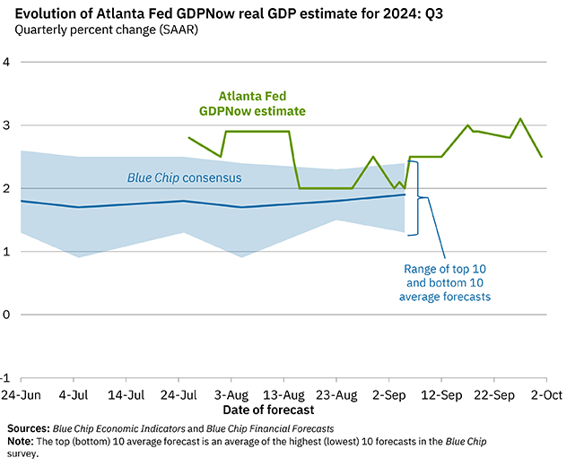
GDP Outlook
Notes:
- 2.5% Q3 GDP forecast currently

Slide 19
Liquidity Should Be Back

Slide 20
But so are Delinquencies…

Slide 21


Slide 22
Recession Risk?
While there are some signs of recession…
  Yield curve inversion to un-inversion
  Rising unemployment rate
  Higher bankruptcies
  Some sentiment surveys
Generally, economists see risk of recession receding currently
If not for fiscal dominance, we likely were in recession in 2022

Slide 23
Yield Curve

Slide 24
Rates Outlook
Notes:
There really isn’t much of an expectation for longer term rates to come down…10yr spreads have been tight due to QE…if we look at forwards curve the 10yr is priced north of 4% at the end of 2025 when the Fed anticipates to be basically done with cuts to 3% on Fed Funds

Slide 25


Slide 26
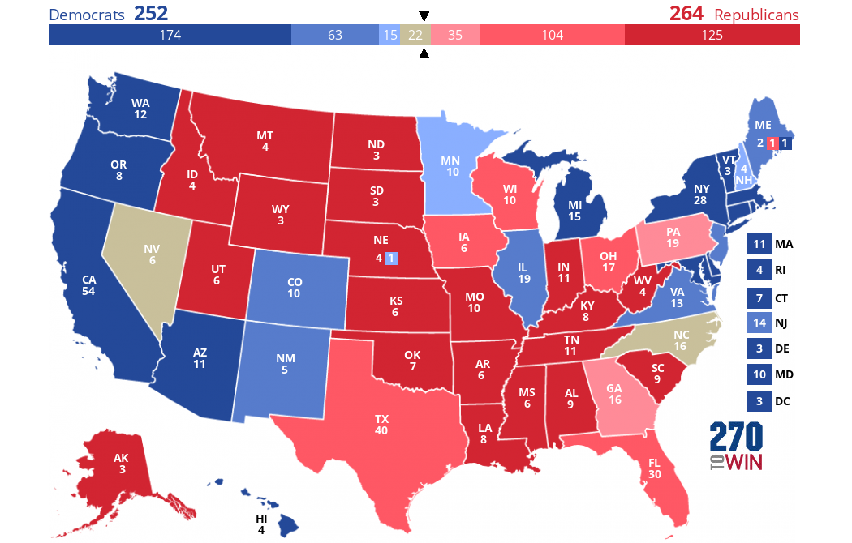
Presidential Race Forecast

Slide 27
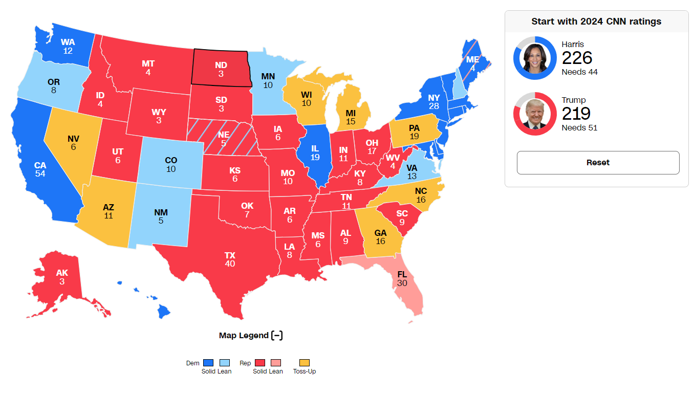
Presidential Race Forecast Cont.

Slide 28
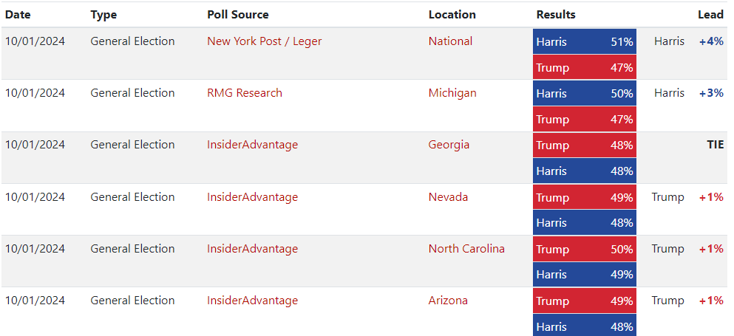
Recent Swing State Polling

Slide 29
Elections Cont..
It’s gonna be close…
Markets are expecting higher long-term interest rates if Trump elected due to fiscally expansionary track records
  Tariffs tend to be inflationary
  Limiting immigration tends to be inflationary
  Plans to make tax cuts permanent not necessarily inflationary
Harris plans to increase taxes (or expire cuts) sounds more fiscally responsible, but only if spending curtailed
Trump does have strong track record for GDP growth and poor track record for government deficits while Harris unknown
It comes down to identity politics, neither party currently prioritizes fiscal conservatism
Notes:
[update]

Slide 30
How Elections Could Impact CUs
Outcomes of House/Senate relative to Presidential outcome perhaps more important
Harris has also been a strong advocate for CDFIs, taking policy lead on nearly $2 billion in CDFI grants
  However, we could also see an emboldened CFPB that could put some non-interest income at risk
Trump administration would likely look at Fannie/Freddie reprivatization again
Trump policies toward FIs generally anticipated to be deregulatory but a 10% credit card rate cap would create some difficult decisions…
With historic track record of strong stock market in incumbent election year and typically inverse relationship between stocks and bonds, bias toward higher interest rates
  With Fed forecasting cuts, this could allow for better NIM opportunities
  Un-inversion (steepening) of yield curve, which we’re already seeing

Slide 31


Slide 32

“Death Star” II: What Could it Be?
Notes:
Delinquencies/Provisions/Charge Offs?
Rates drop too fast and assets reprice faster than liabilities?
Rates reverse higher and cost of funds pressure linger?
Fee income completely disappears?
Commercial Real Estate ripple effects?

Slide 33

Focus on what you can control
Return on Loan = Weighted Average Rate – Costs of Lending
Costs of Lending include:
  Credit Risk
  Servicing Expense
  Cost of Funds
  Other fees
Optional Costs
  Salaries, Overhead
  Offsetting costs such as fee income

Slide 34
Loan Profitability Formula
Return on Loan = Weighted Average Rate – Credit Risk – Servicing Expense – Cost of Funds – Other Costs
Loan profit margin can be compared to risk-free rate (e.g. profit margin available on investments)
Thesis: if we know what it costs to lend, we can make better pricing decisions
Also, we’ve heard examiners suggest that CUs should price loans to generate consistent margin across risk tiers

Slide 35
Exploring Loan Profitability
Credit Risk
Probability of Default Reserve Forecast
Historic Loss Rates
Servicing Expense
Servicing Study allocating costs to different product lines
Cost of Funds
Weighted Avg Cost of Funds
Match funding if appropriate
Other Costs
Indirect Dealer Reserves
Fee Income
Incentives

Slide 36
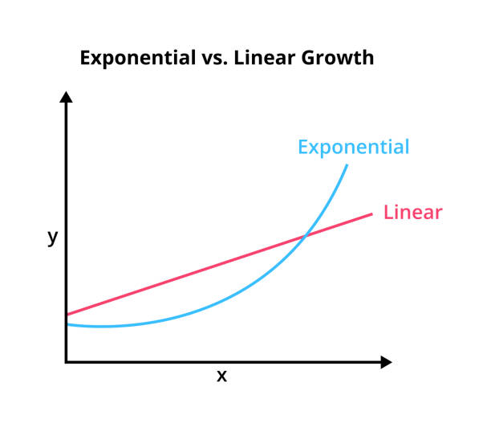
Linear v. Exponential Risk
Financial Institutions often price credit risk (and loan rates) according to a linear yield curve
Credit risk modeling actually suggests something more like exponential growth
We observe generally higher profit margins on middle credit for secured loans
For unsecured we observe higher margins on prime, but negative returns on subprime due to rate cap

Slide 37

Study your Servicing Costs
Traditional benchmark of 25 bps for loan servicing is insufficient for most credit unions
  Most CUs range 50-150 bps from Call Report field 280 alone.
Servicing costs by product vary significantly between different institutions
  Insights can be used to prioritize contract negotiations or marketing campaigns

Slide 38
Example
This credit union learned that servicing credit cards costs nearly 10x the average of the whole portfolio

Slide 39

Key Concept
We can choose to make a lower return on a loan than an investment, but we had better know why.

Slide 40
Minimum Target Rate
Combining our benchmark and profit analysis, we can create a minimum target loan rate
Minimum Target Rate = Credit Risk + Servicing Cost + Cost of Funds + Other Costs + Risk-Free Return

Slide 41

Deposit Thoughts
Credit Unions have seen deposit migration from core deposits into member certificates
  This increases volatility of deposit expense
  Ideally, find a way to incentivize members to move funds back to core deposit accounts
Relative to member certificate specials, wholesale funding can now be more cost effective and “puttable”
  FHLB 3yr borrowings around 3.80%
  Brokered CD issuance rates at or below 4%
Members prefer short term CDs but this increases interest rate risk for the CU, wholesale funding allows better asset-liability matching

Slide 42
Auto Loan Spreads

Slide 43

Final Thoughts
We’ve navigated through interest rate risk and liquidity risk successfully over the last few years
Increasing PLLs and recent cost of funds pressures is a reminder to price assets appropriately
Not all loan growth is necessarily good growth, especially when adverse scenarios materialize
Use your tools, network and collective brain power to be a better balance sheet manager

Slide 44

Contact Information
JD Pisula
jdpisula@accoladeadvisory.com
614-601-1319

