Slide 1
Credit/Debit Growth Strategies
October 10, 2024

Slide 2
Agenda
Dive into Credit Cards first
Website – helpful hint
Debit can actually generate revenue
What next?

Slide 3
What does a Successful Portfolio look like?
1 BIN (reduce processing costs-monthly minimum)
Risk Based Pricing (9.9%, 13.9%, 17.9%)
Rewards (some earn 11 more Basis Points on INT)
Intro Rate/BT (1.9% to 3.9%)
CLIP (make it more visible)
VISA/MC Branding
Business BIN (20 Basis Points MORE)
HELOC (Separate BIN for Tracking purposes)

Slide 4
Credit Cards/Relationships
Members that have your Credit Card are more likely to also do a Car Loan and/or Mortgage with that Credit Union
Members that have your Credit Card are more likely to recommend that Product/Service than other Products/Services

Slide 5
Credit SAFER than Debit
For online purchases, Credit Cards offer better
fraud protection compared to Debit Cards
Additionally, Credit Card users can
dispute charges and initiate chargebacks for
fraudulent or undelivered goods, providing an
added layer of consumer protection
Frank Abagnale quote

Slide 6
Rewards
In the U.S. 93% of ALL Transactions in 2023 were made with a Rewards Card
Be aggressive with Rewards (Double Rewards during holidays……especially Restaurants)
Local merchants

Slide 7
Website: Is it Updated?

Slide 8
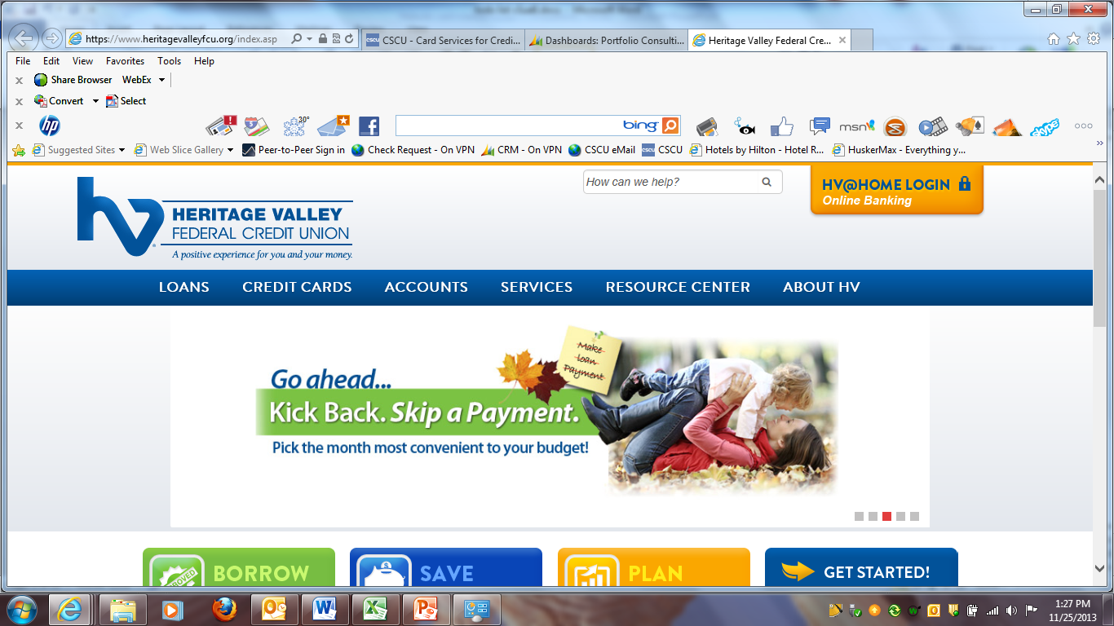

Slide 9
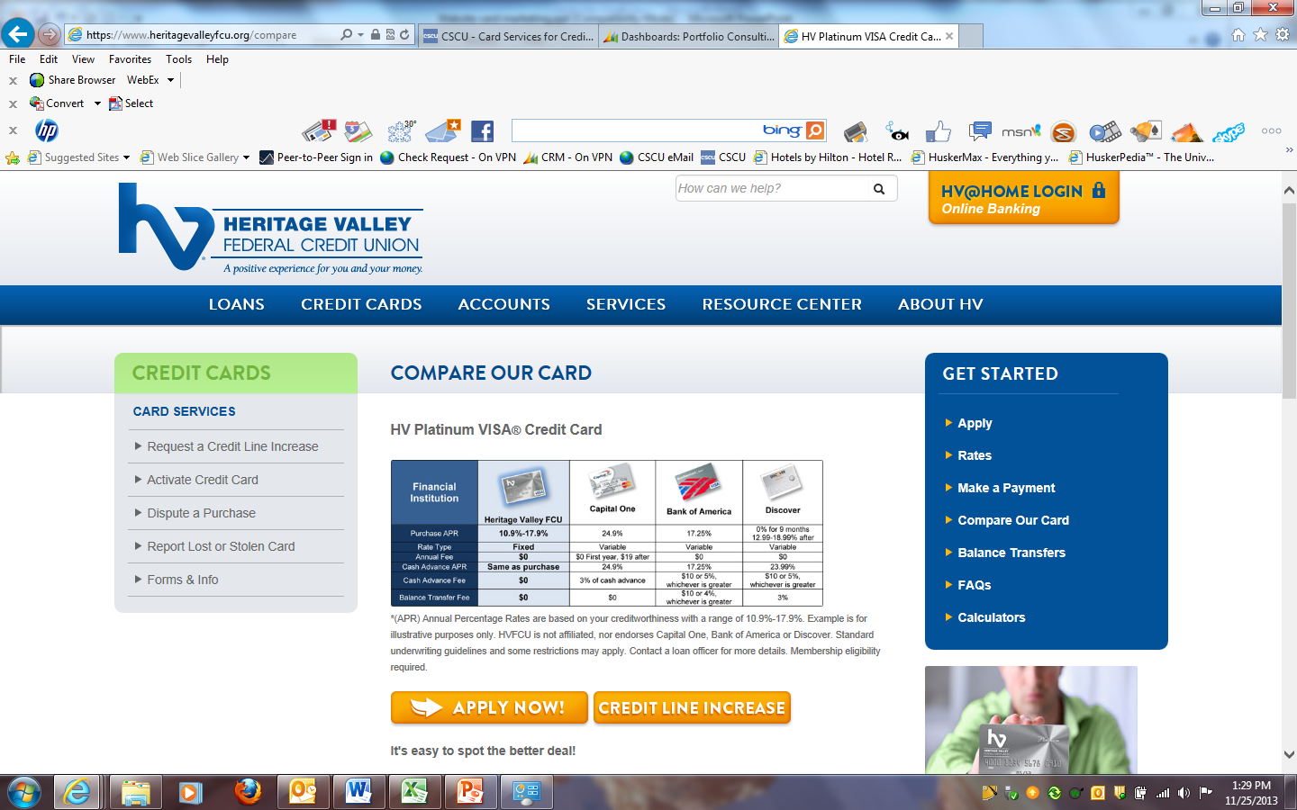

Slide 10
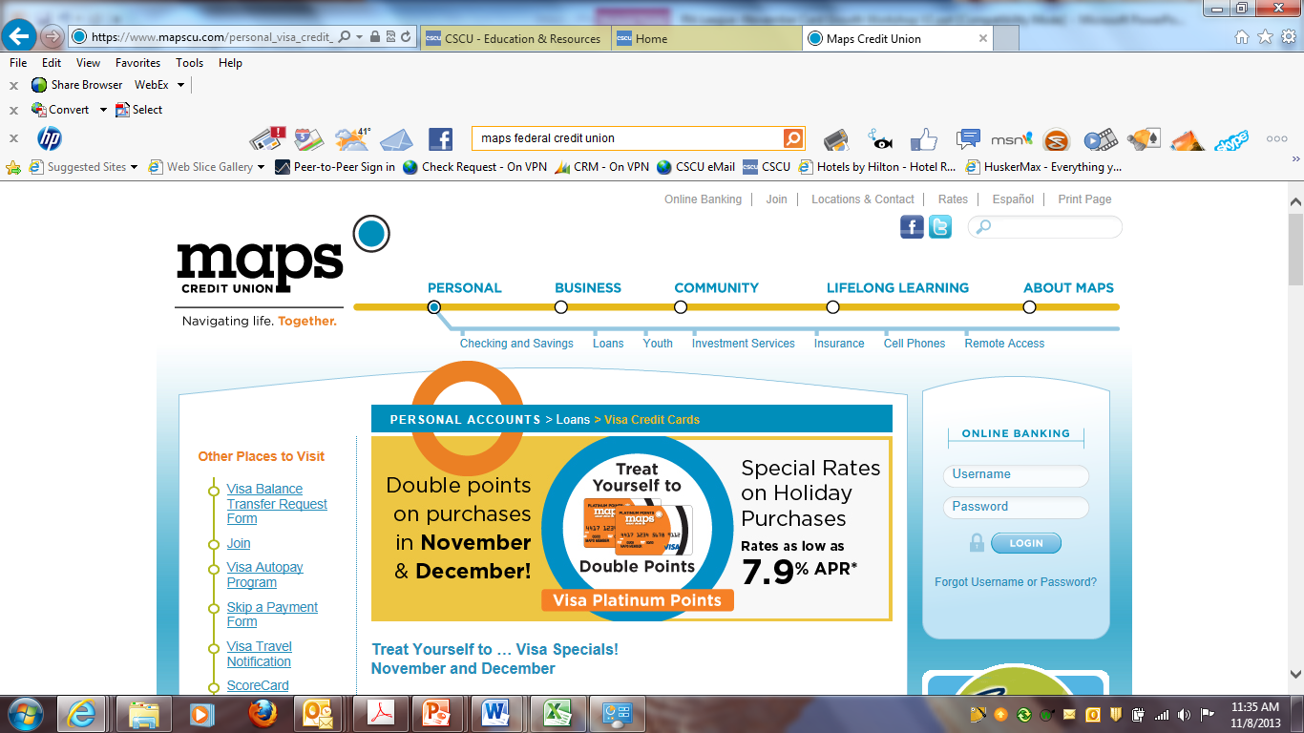

Slide 11
Debit Promos and Stats

Slide 12
Debit Promotion
CU in Grand Rapids, MI
“Drive On” Debit Campaign. Drive On gave members either a $10 gas card for making $500 to $750 in debit card purchases in June or a $20 gas card for making more than $750 in debit card purchases during the same month
Results?
The group’s purchase transactions per card increased from an average of less than six in April to nearly 24 in June. The average spend also increased, from $136 to $1,002 during the same timeframe

Slide 13
10-cent CashBack/Rebate on Debit
$10 Transaction Minimum
Direct Deposit
Maybe start with a 6-month offer
“Don’t Let Others
Nickel and Dime Ya!!”

Slide 14
Rewards drive additional cardholder spend
$626/month vs. $346/month - 80% higher
Annual interchange - $94/account vs. $52/account

Slide 15
Debit Promotion
Double points on all Amazon and iTunes purchases through December 31.
Triple points on ALL purchases November 28 through December 1.

Slide 16
Networks
Too many Credit Unions have WAY TOO MANY NETWORKS!!!!!!
Sophisticated Terminals/Equipment
Only need 2 Networks
NYCE used to pay the CU the most

Slide 17
Next Step?
Which Vendor? FIS/Fiserv/Velera/MAP
Eggs in one basket?
Contract Expiration/Coterminous
3 levels $$$: VISA/MC; Processor; Networks
Major delays

Slide 18
Thanks!!
Ed Jesionowski – Sales Consultant
ed.jesionowski@cuanswers.com
800-327-3478 X 215

